Slide 1

Title here

Slide 2

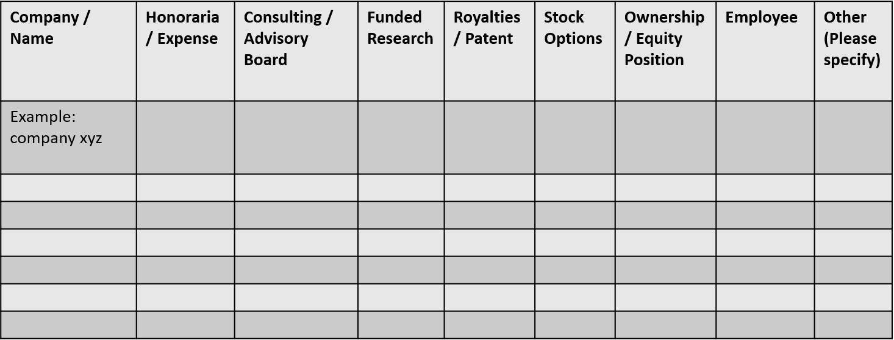
 | No, Nothing to disclose
 | Yes, please specify

