Slide 1
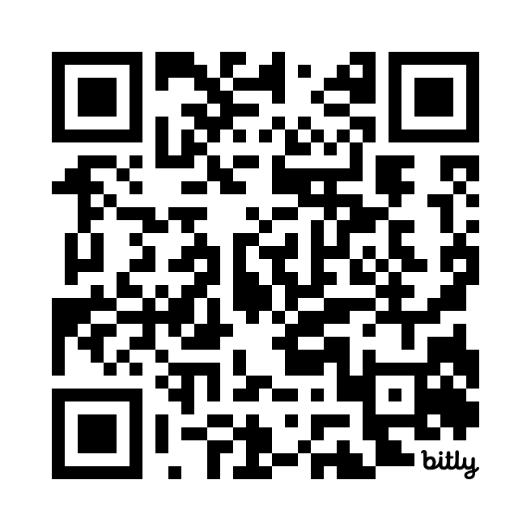
JOIN US

Slide 2
 | No, Nothing to disclose
 | Yes, please specify

